Slide 1
Data Stuctures and Algorithms
Dr. Fidaa Abed

Slide 2
Data Structures
Stack
Queue
Priority Queue
Deque
List
Unorder Set
Sorted Set

Slide 3
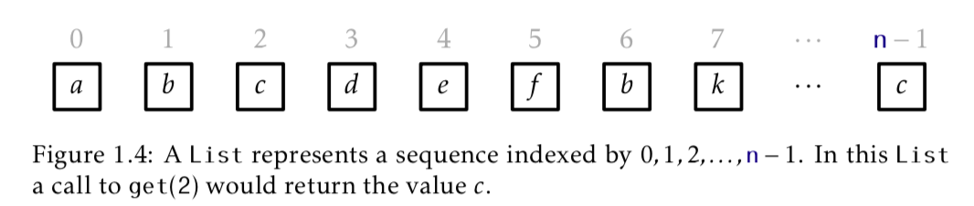
List
General data structure
Operations:
add(i,x), remove(i), set(i,x), get(i)
Application: Stack, Queue, Deque

Slide 4
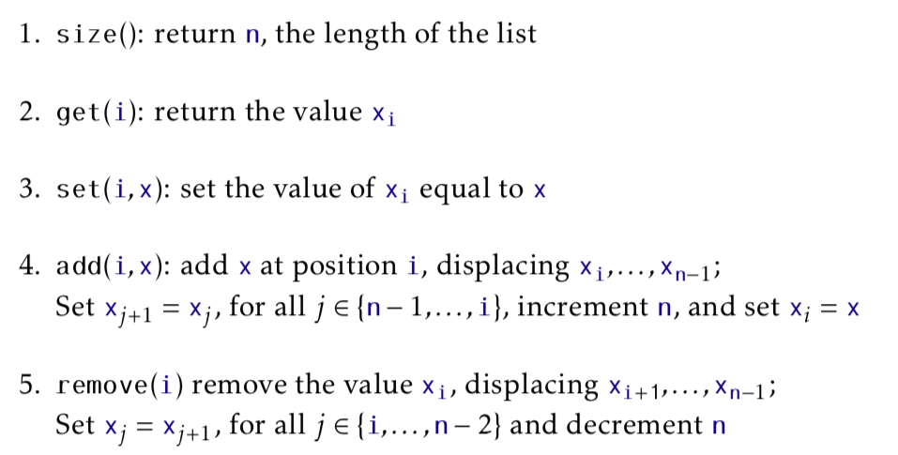
List operations

Slide 5
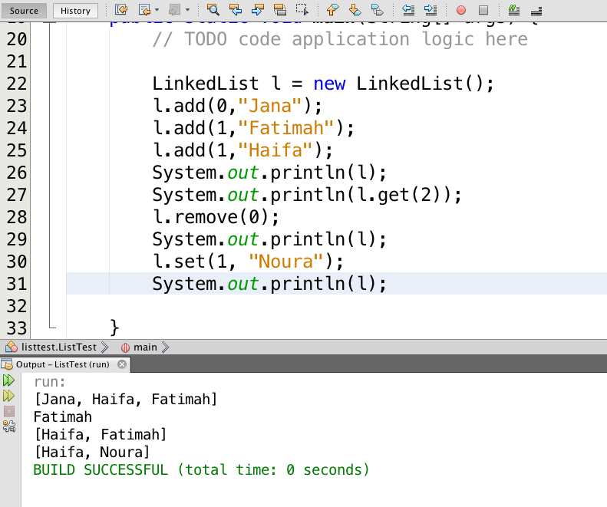
List Example

Slide 6
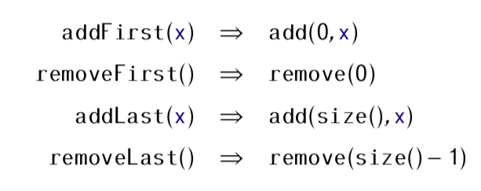
List to Deque

Slide 7
Unorder Set
Unorderd
Unique: no repetition
Similar to the mathematical set

Slide 8
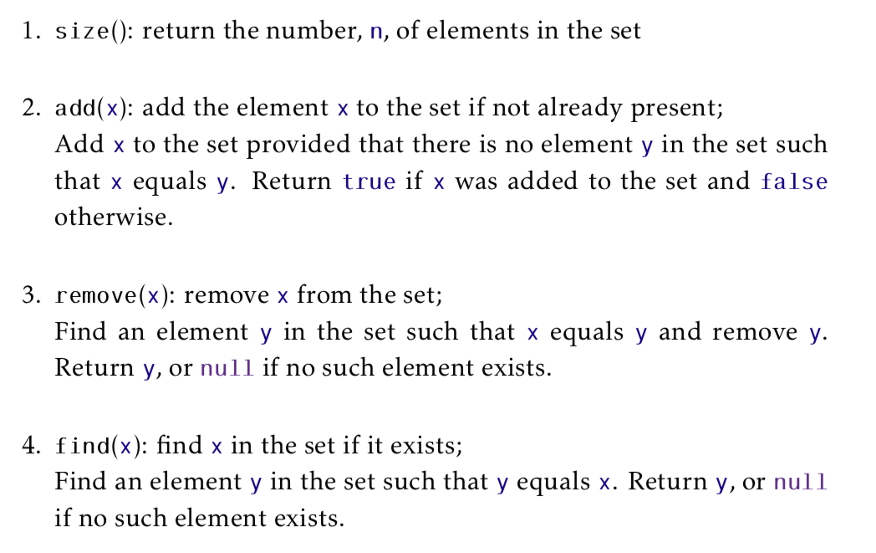
Unorder Set Operations

Slide 9
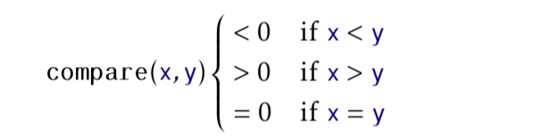
Sorted Set
Sorted based on an order
Unique: no repetition
Similar to the mathematical set

Slide 10
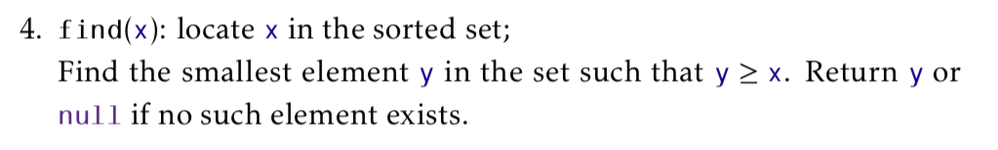
Sorted Set Operations

Slide 11
Asymtotic Notation
To compare the running time of operations
Exact running times varies from computer to computer
Solution 1: Count the number of operations
Hard to count exactly
Solution 2: Asymtotic Notation

Slide 12
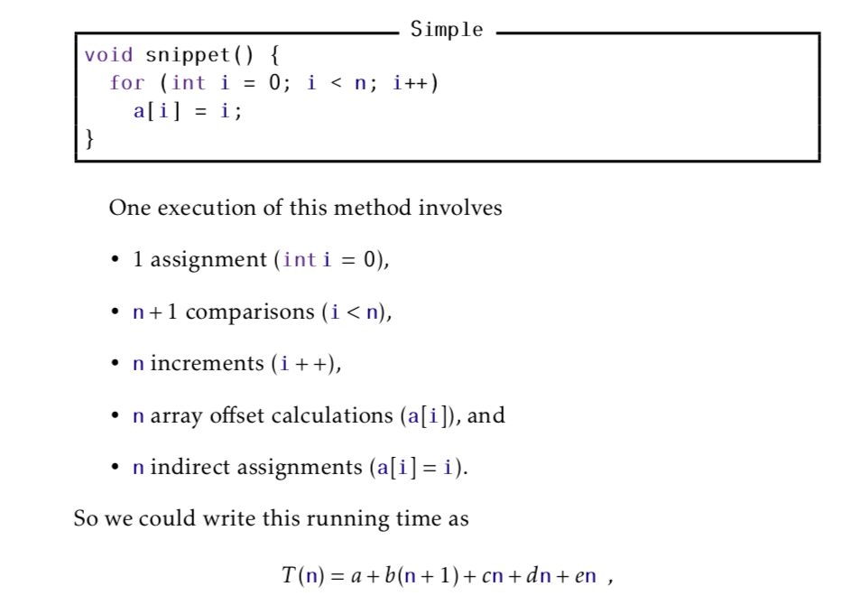


Slide 13
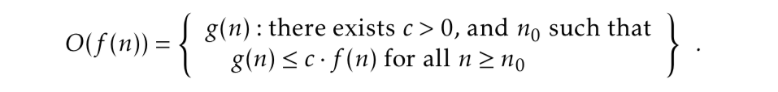
Big-Oh notation

Slide 14
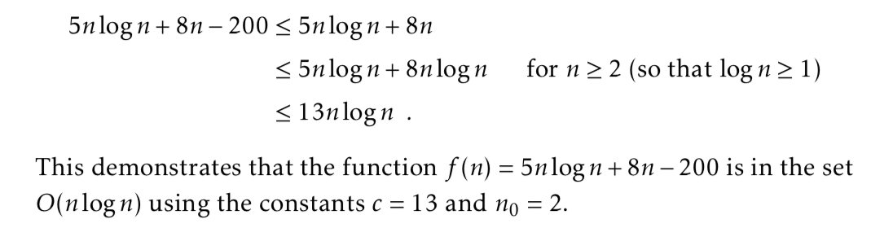
Big-Oh notation

Slide 15
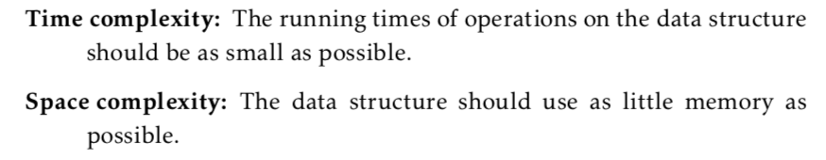
Time Complexity vs. Space Complexity

Slide 16
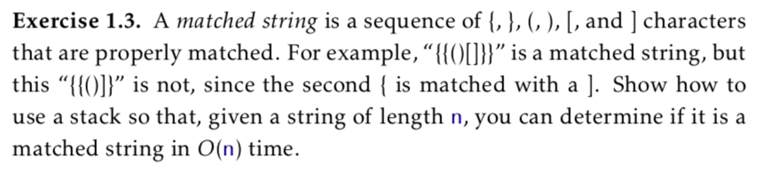
Exercise

Slide 17
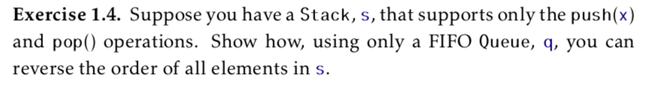
Exercise

